Slide 1

The 32nd P.A.R.K. Conference
Write To Ignite
Thomas Mander-Jones

Slide 2
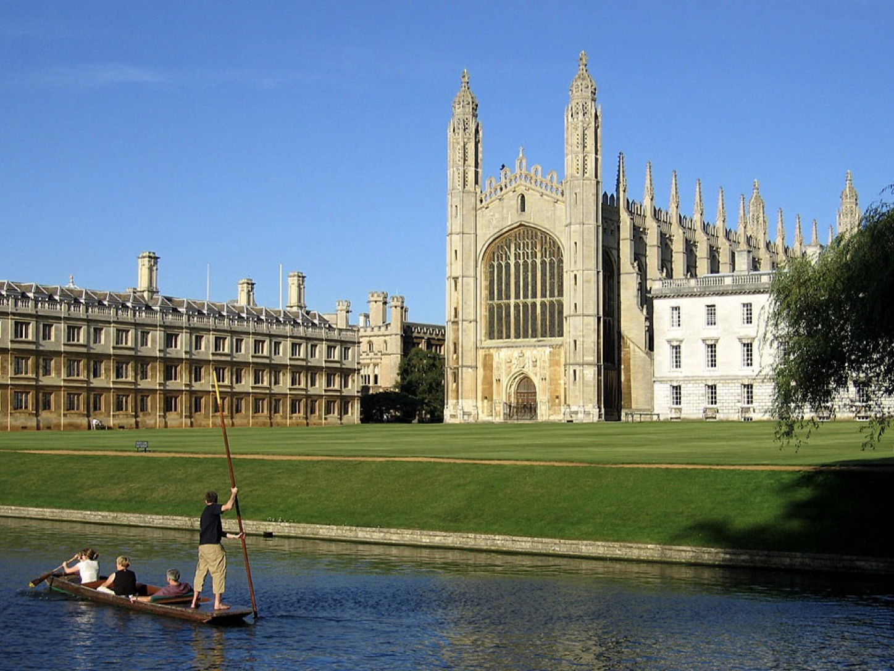


www.zkouskypark.cz
WRITE TO IGNITE

Slide 3

AIMS OF THE SEMINAR
Personalisation Of Writing Content.
DEVELOPING Content Strategically --- BRAINSTORMING!!!
WRITING SKILLS: Creating GREAT Starts, (Middles) & Ends
GAME: Connector Duel
JOKE: Develop Cohesion & Linking / Descriptive
www.zkouskypark.cz

Slide 4

1. PERSONALISATION
Builds Curiosity
Prompts Imagination
Provides Content (for writing)
www.zkouskypark.cz

Slide 5
PERSONALISATION
A recent experience you had <Up to 7 words>
e.g I went to Albert to buy milk.
Swap it with your partner. Ask follow up questions.
e.g What did you need the milk for? When did you go?
Write about your partner’s experience in 50-100 words.
Groups of x4. Exchange stories & comment.
IMPRESSION???
www.zkouskypark.cz

Slide 6
PEER EVALUATION
content
accuracy
range
organisation
linking
impression
VOTE
www.zkouskypark.cz

Slide 7
2. BRAINSTORMING - Benefits???
Reduces writer’s block
*Improves organisation
Activates vocabulary
Generates discussion
www.zkouskypark.cz

Slide 8
EXAM TASK
Part 1 – Essay
In your English class you have been talking about online learning. Now your teacher has asked you to write an essay.
Write an essay using all the notes and give reasons for your point of view.
Write your answer in 140–190 words.
flexibility and confidence
lack of face-to-face interaction
your own idea
www.zkouskypark.cz

Slide 9
BRAINSTORM Pros & Cons Of Online Learning
Paragraph 1
flexibility and convenience
lack of face-to-face interaction
Paragraph 2
development of digital skills
self-paced learning
cost-effectiveness
Paragraph 3
technical problems
limited practical experience
distractions at home

Slide 10
3. MAKING A START
HOOK
BRIDGE
THESIS
www.zkouskypark.cz

Slide 11
lack of face-to-face interaction
MAKING A START (Practise)
HOOK
“There is ongoing debate about whether online learning can truly replace traditional
classroom education.”
BRIDGE
“While some people believe it provides greater flexibility and accessibility, others
argue that it limits interaction between students and teachers.”
THESIS
“This essay will examine both the advantages and disadvantages of online learning
before reaching a conclusion.”
www.zkouskypark.cz

Slide 12
ARTICLES
MAKING A START (Using Rhetoric)
REVIEWS
TRAVEL ARTICLE
REFLECTIVE
“It is really worth visiting a city that promises culture but delivers crowds and queues?”
PROVOCATIVE
BOOK REVIEW
“How often do we come across a novel that makes us question our own morals?”
RESTAURANT REVIEW
HYPOTHETICAL
“Could a meal be as memorable as the company you share it with?”
www.zkouskypark.cz

Slide 13
Rhetorical Beginnings:
REFLECTIVE/PERSONAL
“Have you ever (wondered/imagined) ...?
“Do you remember a time ...?
PROVOCATIVE
“Can anyone honestly say ...?
“Isn’t it time we ...?
HYPOTHETICAL
“What if I challenged you ...?
“What would happen if ...?
www.zkouskypark.cz

Slide 14
ENDINGS (Proverbs)
NAME AS MANY
PROVERBS YOU CAN IN
JUST 1 MINUTE
www.zkouskypark.cz

Slide 15
IMPROVING ORGANISATION (Proverbs)
Story:
“After failing her driving test twice, Anna felt like giving up. However, she kept practising, determined to succeed. On her third attempt, she finally passed, proving to herself that persistence matters more than talent. In moments like these, it’s clear that...”
practise makes perfect.
Review: (productivity app)
“This app allows teams to organise tasks and communicate more effectively. Although there are occasional technical issues, working together becomes much easier and more efficient. It proves that collaboration leads to better results —”
two heads are better than one.
www.zkouskypark.cz

Slide 16
4. GAME (Connector Duel)
however
as a result
for example
on balance
Smartphones make us less intelligent.
in addition
A.I will take over all our jobs.
nonetheless
Money really can buy happiness.
Luxury brands manipulate people.
therefore
moreover
for instance
furthermore
www.zkouskypark.cz

Slide 17
5. JOKE
Cohesion & Linking
Descriptive Language
Dialogue In Storytelling: Narration + Speech
www.zkouskypark.cz

Slide 18
There were three travellers, a Rabbi, a Hindu and a politician, who were walking down a country lane one dark and stormy night looking for accommodation. They stopped at a small inn when the innkeeper, a large, gruff-looking man, appeared from the entrance with a brass nose stud. He regretted that there was only one twin room left and that one of the travellers would have to sleep in the barn.
Despite this, the travellers agreed to take the room and the Hindu kindly offered to sleep in the barn. The innkeeper showed the Rabbi and the politician to the twin room.
Ten minutes later, there was a loud knock at the door and the Hindu was standing there with an anxious look on his face.
“I’m sorry,” he said. “There’s a sizable cow in the barn and to me a cow is a sacred animal, so I can’t possibly sleep there.”
The Rabbi told him not to worry and to take his bed, as he didn’t mind sleeping next to a cow. He went to the barn, but five minutes later there was a knock at the door. It was the Rabbi with a sorrowful look on his face.
“I’m terribly sorry, but there’s a pig in the barn and to me a pig is an unclean animal. I can’t sleep in there!”
The politician offered to go and sleep in the barn. He climbed out of bed and let the Rabbi have his bed and walked towards the barn.
When he arrived at the barn the Hindu and Rabbi had settled down to sleep. All was quiet, but fifteen minutes later there was another loud knock at the door and the cow and the pig were standing there.
www.zkouskypark.cz

Slide 19
THANK YOU
www.zkouskypark.cz

