Slide 1

The 32nd P.A.R.K. Conference
Scroll, Think, Speak: Media Literacy in Language Learning
Zdeňka Zvoníčková

Slide 2



My Fulbright experience
TEA Program
What I missed :
Practical use and steps

Slide 3
Why include media education in ESL?
Relevance and authenticity
Language skills
Critical thinking
Better cultural awareness

Slide 4
It may sound easy and convincing but:
Time consuming preparation
Little support for teachers
Uneasy discussions
Being no expert or political activist

Slide 5


How to start
Set the stage with debates and rules
Start with topics that you are familiar and comfortable with
Do not get discouraged if the lesson does not go according to plan
Be aware of your own bias: https://www.allsides.com/rate-your-bias

Slide 6
Topics to cover
Exploring bias in a news item
Word choice (loaded language)
Headlines
Comparing a news item through various sources
Checking for fakes or hoaxes (Fact checking sites)
Understanding political leanings of a news outlet

Slide 7
Exploring bias
https://mediabiasfactcheck.com/left-vs-right-bias-how-we-rate-the-bias-of-media-sources/
Spin (technique of presenting facts to influence how they are perceived )
Slant (telling only parts of a story to support one side)

Slide 8
Spin the story so it sounds positive
Activists disrupt city center, blocking traffic

Slide 9
Misleading headlines
Coffee Erases Liver Cancer Risk Caused By Daily Alcohol Consumption
Shark attack numbers remained 'extremely low' in 2020

Slide 10
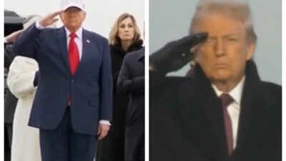
Use of visuals
On Saturday, March 7, 2026, President Trump attended a dignified transfer ceremony at Dover Air Force Base for six U.S. service members killed in Kuwait.

Slide 11
Understanding news
Divide these headlines into three categories : left, centre, right
https://www.allsides.com/bias-checker

Slide 12
Loaded language
Language whose aim is to evoke emotions, sway audiences, or influence judgments or push some agenda.
Words signalling anger, un/certainty, doubt, anxiety, political leanings, etc.

Slide 13


Left word choice
Right word choice
pro-choice
pro- abortion
gun control
protest
migrants / asylum seekers
undocumented immigrants
tax fairness
corporate greed
pro-life
anti- abortion
gun rights
riot
illegal immigrants
illegal aliens
tax burden
deregulation, free market

Slide 14
Questions to ask when reading news
What is the source?
How is the story covered by other sources, what is the focus and emphasis
If experts are invited, who are they? Do they have any link to the story or personal interests? Are they there to corroborate the story?
How is language used to make an impact?
What visuals accompany the story?

Slide 15
Ready made resources
Common sense (Above the Noise)
Teen Voices
Chatting safely online lesson plan

Slide 16
Ready made resources
AllSides
British Council
Ground News

Slide 17
Factchecking sites
Bellingcat
BBC Verify
Politifact

Slide 18

Motto: We never tell you who is right or wrong, just their political bias — so you can get the full picture and decide for yourself.
zzvonickova72@gmail.com

