Slide 1
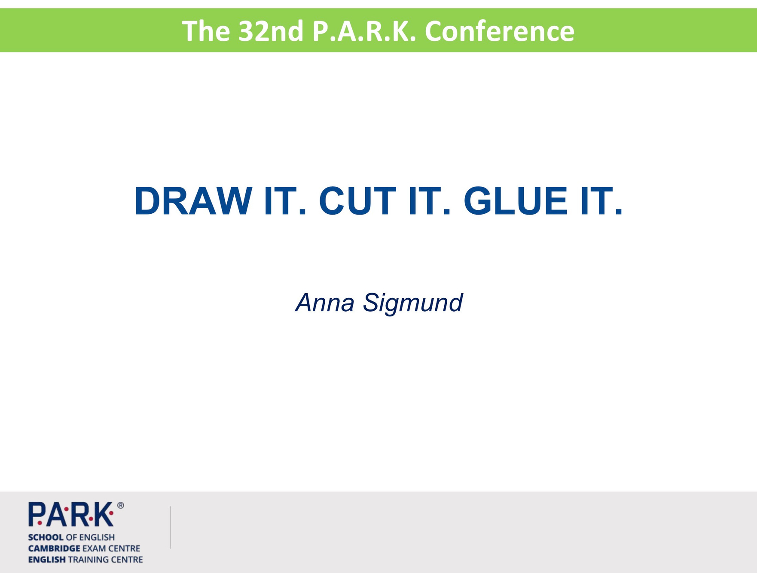

Slide 2


Anna Sigmund
Draw it
Cut it
Glue it
Arts & Crafts
Notes:
My name is…
I currently work for Park as a freelance teacher and I have been teaching for about 10 years.
As you know this session is about arts & crafts. Draw yourself. This is me -
You might not imagine this, but I am not an artsy craftswoman !
Nevertheless, I find it engaging and fun when done right in English lessons.
What's your experience with arts & crafts? Why do you do it / why not?

Slide 3
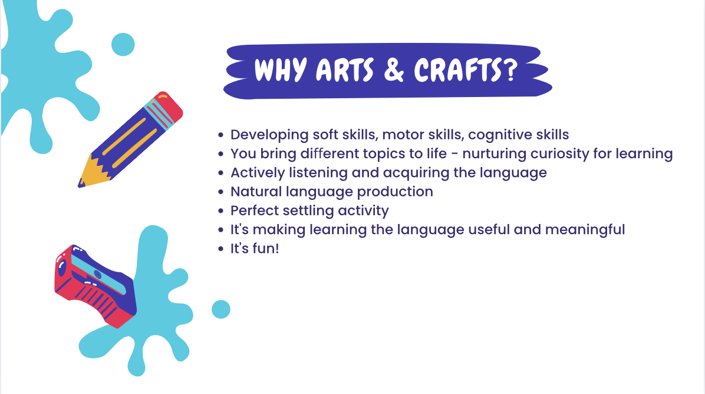
Notes:
Why do you do it in your lessons?
What are the benefits – brainstorm
Developing life skills – especially with YL I believe it’s important
For some it’s desirable to get more visual – bring it to life
Language production can not only be connected to the target language but also to natural interaction – when you can pre-teach phrases such as: Can I borrow the scissors?

Slide 4
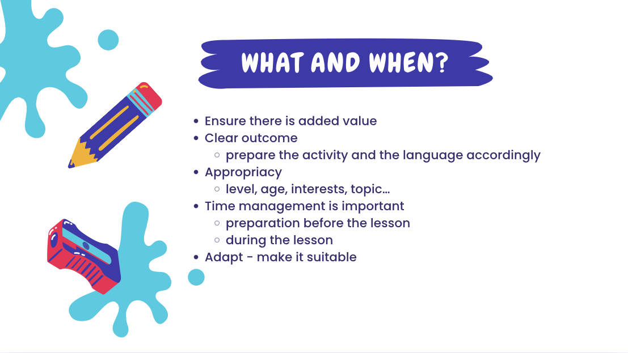
Notes:
We said it‘s fun, but do not do it just for the sake of doing arts & crafts
There has to be clear outcome
- Need to make sure they understand instructions (draw, scissors, fold – VYL might need to pre-teach this)
Also the target language –e.g. colours
When it comes to choosing the appropriate activity, of course you‘ll think of the level and age
this goes further than that – hobbies (not drawing footbal field with bunch of pre-teen girls who like shopping)
choosing your audience carefully – some pre-teens are very mature whereas some childish activities might be okay with a group of teens or even adults!
Couple of tips
- prep well befohand – indeed, it takes time, but then during the lesson you can simply monitor, help, create some natural conversation
prepare an example and show it to them – motivates the students, plus helps students with execution
make sure you and children have available materials – glues, scissors etc.
always demonstrate everything – be very clear
What does adaptation mean?
need to ask yourself how long is it going to take, what are my students like in terms of pace
e.g. for first and second graders, you won‘t have them write anything or you‘ll cut everything before the lesson
if you know they take their sweet time colouring – you print on coloured paper

Slide 5
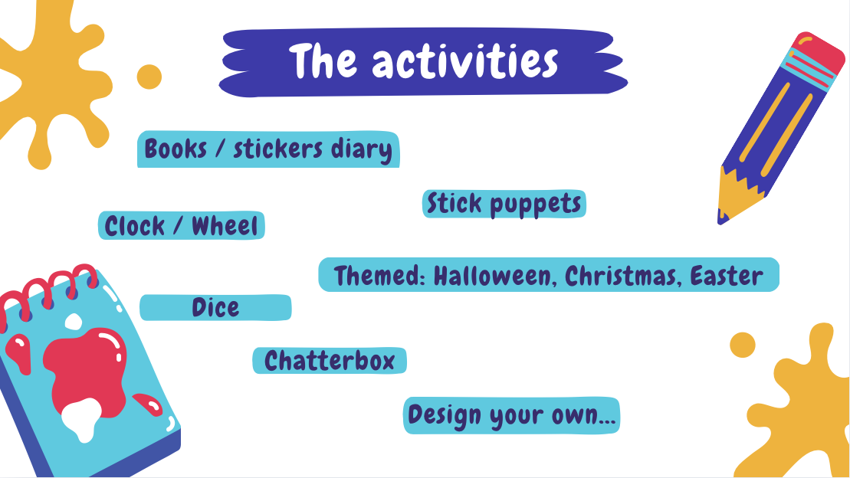
Notes:
Discuss – what do you think can be done with these
I‘ll share:
- Books – for storytelling
Stickers diary – reward systém, first lesson
Stick puppets – Old MacDonald, role play
Themed: Easter Egg Hunt, Christmas headband, Halloween Jack, bookmark, Summer poster
Map of a city

Slide 6
THANK you!

